Slide 1

Dietary diversity as a holistic solution for resilient food and nutritional security
Dr.Binod Kumar Singh
Medical Superintendent,NMCH,Patna
Professor & Head
Dept. of Pediatrics, NMCH, Patna
IAP State President, Bihar- 2019
IAP State Vice-President, Bihar- 2018
CIAP Executive board member-2015
NNF State president, Bihar- 2014
IAP State secretary,Bihar-2010-2011
NNF State secretary,Bihar-2008-2009
Fellow of Indian Academy of Pediatrics (FIAP)
Chief Consultant
Shiv Shishu Hospital
K-208, P.C Colony,Hanuman Nagar,
Patna – 800020
Web site : www.shivshishuhospital.org,Mob:-9431047667

Slide 2
Will be discussed under following headlines
Pregnant women nutrition its evidences and food diversity
Lactating women nutrition its evidences and food diversity
Optimal nutrition of infant below 6 months and its evidences including preterm nutrition
Nutrition of children below 5 years

Slide 3
DIETARY GOALS
Maintenance of a state of positive health and optimal performance in populations at large by maintaining ideal body weight.
Ensuring adequate nutritional status for pregnant women and lactating mothers.
Improvement of birth weights and promotion of growth of infants, children and adolescents to achieve their full genetic potential.
Achievement of adequacy in all nutrients and prevention of deficiency diseases.

Slide 4
Nutrients can be divided into different types based on the way in which they are classified. There are two major ways in which nutrients can be classified. They are:
On the basis of how the body responds to a nutrient deficiency
On the basis of quantity required by the body
Classification of Nutrients
On the basis of how body responds to nutrient deficiency
Type I
Type II
On the basis of quantity required by the body
Macro nutrient
Micronutrient

Slide 5
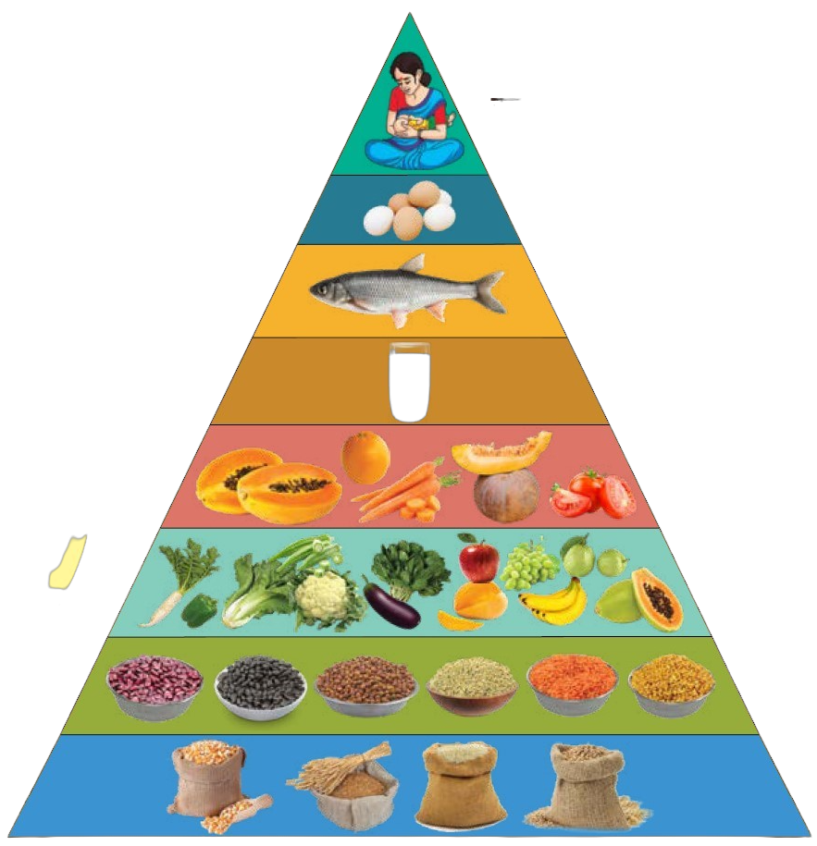
Dietary Diversity:
Dietary diversity is defined as the number of different food groups or foods consumed over a given references period.
It is a qualitative measure of food consumption that reflects household access to a variety of foods and is also a proxy for nutrient adequacy of the diet of individuals.

Slide 6
Minimum Dietary Diversity for Women
MDD-W is a dichotomous indicator of whether or not women 15 to 49 years of age have consumed at least five out of ten defined food groups the previous day or night.
The ten food groups for Women:
Grains, white roots and tubers, and plantains 2. Eggs
Pulses (beans, peas and lentils) 4. Dark green leafy vegetables
Nuts and seeds 6. Other vitamin A-rich fruits and vegetables
Milk and milk products 8. Other vegetables
Meat, poultry and fish 10. Other fruits
(women who have consumed at least 5 of the 10 possible food groups over a 24-hour period are classified as having minimally adequate diet diversity)

Slide 7
Pregnant women nutrition -its evidences and food diversity
Nutrition is a key modifiable factor that affects birth outcomes and has long-term effects on the health of offspring.
Undernutrition and overnutrition can be associated with adverse pregnancy outcomes.
The developmental model for the origins of disease (ie, Barker Hypothesis) hypothesizes that the fetal environment causes epigenetic modifications that impact gene expression and there by influence development of disease in children and adults.

Slide 8
Potential pregnant women need attention regarding nutrition counselling includes :-
Use of supplements
Food avoidances/special diets/skipping meals
Eating disorders
Lack of resources for adequate nutrition
Low intake of nutrient-dense foods (fruits and vegetables)
High intake of added sugars and fats (fried foods, processed foods, desserts)
Overweight or obesity
Medical history of bariatric surgery or other conditions that cause malabsorption
Substance misuse

Slide 9
The incidence of pregnancy complications is higher at the upper and lower extremes of weight gain.
Recommendations for weight gain during singleton pregnancy are :-
-Maternal BMI <18.5 kg/m² (underweight) – weight gain12.5 to 18.0 kg
-Maternal BMI 18.5 to 24.9 kg/m² (normal weight) – weight gain 11.5 to 16.0 kg
-Maternal BMI 25.0 to 29.9 kg/m² (overweight) – weight gain 7.0 to 11.5 kg
-Maternal BMI ≥30.0 kg/m² (obese) – weight gain 5 to 9.0 kg

Slide 10
Daily Requirement of Macro and Micronutrients
The daily multiple calories, macronutrients, micronutrient supplements should contain key vitamins/minerals
CALORIES-
Key nutritional factor in determining birth weight
Increase daily caloric intake by 340 to 450 additional kcal per day in 2nd and 3rd trimester respectively
MACRONUTRIENTS-
PROTEIN-Fetal/pregnancy unit consumes 1 kg of protein during pregnency
Intake of pregnant women-1.1g/kg/day
Use of protein powder or high protein beverages should be discouraged.
CARBOHYDRATES-
Increase to 175 g/day, up from 130 in non pregnant women
Highly processed food should be minimized.
Fiber intake-28g/day along with adequate fluid intake to prevent constipation
FAT-Trans fatty acid have adverse effect on fetal growth and development by interfering with essential fatty acid metabolism.
TFA should be minimized or avoided .

Slide 11
MICRONUTRIENTS
IRON
Fetal/placental development
Expand the maternal red cell mass
Most bioavailable form is heme iron which is found in meat, poultry and fish
Absorption of non heme iron is enhanced by vit c rich foods or muscle tissue and inhibited by dairy products, coffee/tea/cocoa.
Women with iron deficiency anemia (<11g/dl Hb in first or 3rd trimester) should receive an additional iron supplement (30 to 120 mg per day) until the anemia corrected.

Slide 12
CALCIUM
FETAL SKELETAL DEVELOPMENT requires about 30 gm of ca during pregnancy
RDA-1000 mg/day
Calcium supplementation do not reduce the preterm birth or low birth weight
VIT D
RDA-600IU for all reproductive age women, including during pregnancy or lactation
Above RDA do not reduce adverse pregnancy outcome(preeclampsia or stillbirth).
FOLIC ACID
0.4 to 0.8 mg one month before and for the first two to three months after conception
Reduce the risk of child with a neural tube defect.
0.6 mg per day thereafter to meet the growth needs of the fetus and placenta
4mg per day for women known to be at increased risk for NTD(HISTORY OF PREVIOUSLY AFFECTED INFANT,MATERNAL USE OF ANTICOVULSANT).

Slide 13
Zinc
Essential for normal growth
Increases birth weight
Does not improve any pregnancy outcome except 14% reduction in preterm births.
Women at risk for severe zinc deficiency are-
active inflammatory bowel disease
acrodermatitis enteropathica , pica
IODINE
WHO—250 mcg during pregnancy and lactation.
Thyroid association recommends that women who are planning pregnancy, lactating or pregnant supplement their diet with oral multivitamin that contains 150 mcg of iodine in form of potassium iodide.

Slide 14
VIT A
Non pregnant -700mcg/day
Pregnant women-770 mcg/day
In developing countries deficiency is concerned as it is associated with maternal xeropthalmia, night blindness, anemia and infections
In endemic area a weekly supplement less than 25000 IU appears to have some maternal and fetal/neonatal health benefits.

Slide 15
ADVERSE EFFECTS FROM EXCESSIVE SUPPLEMENTATION AND DIETRY INTAKE
VIT A
CAN BE TERATOGENIC
Avoid liver consumption during pregnancy as it is rich in Vit A
IODINE
Can cause fetal goiter
VIT D
Safe upper limit-4000 iu daily(100mcg)
VIT E
Self reported abdominal pain and premature rupture of membrane at term. women should take a supplement of 0.4 to 0.8 mg per day. Higher doses (4 mg per day) are recommended for women known to be at increased risk for offspring with neural tube defects.
Excessive intake of vitamin A (greater than 10,000 international units per day) and/or iodine can have harmful fetal effects.

Slide 16
Lactating women nutrition
Early feeding and nutrition are of importance in the origin of adult diseases such as type 2 diabetes, hypertension, obesity, and the metabolic syndrome
The American Academy of Pediatrics (AAP) and World Health Organization(WHO) have declared breastfeeding and the administration of human milk to be the normative practice for infant feeding and nutrition.
Maternal milk production is dependent upon mobilization of maternal stores and dietary consumption.

Slide 17
BODY WEIGHT
Changes in maternal body composition vary during breastfeeding. Typically, there is a mild gradual weight loss during the first six months postpartum, with preservation of lean body mass.
Infant demand is the major factor in determining milk volume.
Maternal factors associated with decreased milk volume include maternal stress, anxiety, fatigue, illness, maternal insulin resistance, hormonal oral contraceptives, and smoking.
Lactation requires additional energy and nutrients in the maternal diet including protein, vitamins A and E, and several other vitamins and minerals
Mild to moderate variations in maternal diet, energy balance and aerobic exercise don't affect milk production
15% decrease in milk production when calories intake < 1500 /day .

Slide 18
MILK VOLUME
750 to 800 ml per day
Can exceed 2000 ml per day in hyper-lactation or nursing twins or triplets
Low on the first 2 days, increased markedly on day 3
Addition of milk substitutes or solid food reduces infant demand and decrease milk production

Slide 19
Calcium and Vitamin D supplementation
The recommended intake for calcium and vitamin D by lactating women are the same as for nonlactating women.
This is because maternal bone mineral content, which typically declines during lactation then rebounds after weaning, is not affected by the mother's intake of these nutrients.
Breastfeeding does not increase the risk of low bone density, osteoporosis or fracture in long term.
Breast milk is low in vitamin D and supplementation to the infant is required to prevent rickets.
Rarely used strategy is supplementation of high dose of vit D to lactating mother -can lead to toxic level in milk

Slide 20
Other Fat-soluble Vitamins to mother and baby
VIT K is low in breastmilk
routine administration of vit k to neonate to prevent vit k deficiency & bleeding.
VIT A
Supplementation no longer recommended for lactating women, neonate and infant up to 6 months of age.
High dose of vit A in infant and children 6m to 59 month where vit A deficiency is public health problem.

Slide 21
Components of Optimal IYCF
Initial Breastfeeding
Exclusive Breastfeeding
Exclusive breastfeeding for the first six months of life (No other foods or fluids, not even water)
Complementary Feeding
Timely introduction of complementary food (maintaining adequate diet and dietary diversity) beyond six months along with continued breastfeeding
Early initiation of breastfeeding; immediately after birth, preferably within one hour
Active feeding of children during and after illness

Slide 22

Breastfeeding- Healthy Bodies, Healthy Brains
Breastfeeding alone can
Reduce Under-5 mortality by 13%
Prevent 39, 00, 000 episodes of diarrhea
Prevents 34, 36, 560 episodes of pneumonia
Improves IQ in children by 3 points
Prevents 4, 915 deaths due to breast cancer
Reduce obesity by 26%
Reduce type-2 diabetes by 35%
Add Rs. 4, 300 crores to the economy
Lancet 2013: initiation within the first 24 hours associated with 45% reduction in all-cause neo-natal mortality. (LANCET/BPNI)
Source: Lancet/BPNI

Slide 23
Diet for Pre-mature (weighing less than 2000 g.) Children
(Babies who were born early (before 37 weeks) or at a low birth weight (less than 5 pounds, 8 ounces) need special nutrition to help them catch up on growth. Breast-fed babies may get a fortifier added to the milk)
Protein and mineral content of human milk is insufficient to meet the needs of the growing preterm infant.
Fortification of Human Milk is indicated in order to supply the nutrients required and support the rapid rate of growth and bone mineralization in the preterm infant.
Human Milk Fortifier (24 kcal/oz) is indicated for all breast milk fed infants weighing less than 1500 gm & added till 40 wks post menstrual age (PMA) or attains 2 Kg
Human Milk Fortifier (24 kcal/oz) should be initiated when the infant is tolerating breast milk feeds of > 100 ml/kg/day.
Lactodex HMF -25ml EBM with 1 gm sachet.

Slide 24
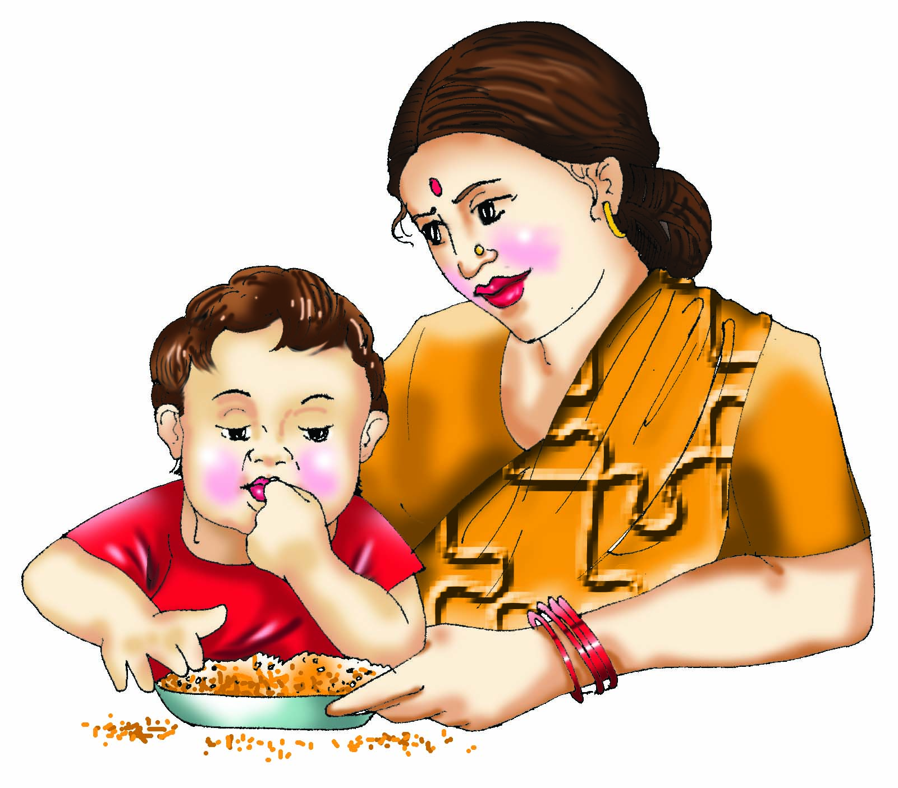
Feeding of Children beyond 6 months (Complementary feeding)
The process of giving an infant other foods and liquids along with breast milk or non-human milk as breast milk alone is no longer sufficient to meet the nutritional requirements.
These foods should complement rather than replace breastmilk.

Slide 25

Minimum Dietary Diversity for Children (6 Months To 5 Years)
MDD-C is a dichotomous indicator of whether or not children 6 months to 5 years of age have consumed at least five out of Eight defined food groups the previous day or night.
The ten food groups for Children:
Breastmilk 2. Grains, white roots and tubers, and plantains
Pulses (beans, peas and lentils) 4. Milk and milk products
Eggs 6. Meat and fish
Other vitamin A-rich fruits and vegetables 8. Other fruits and vegetables

Slide 26
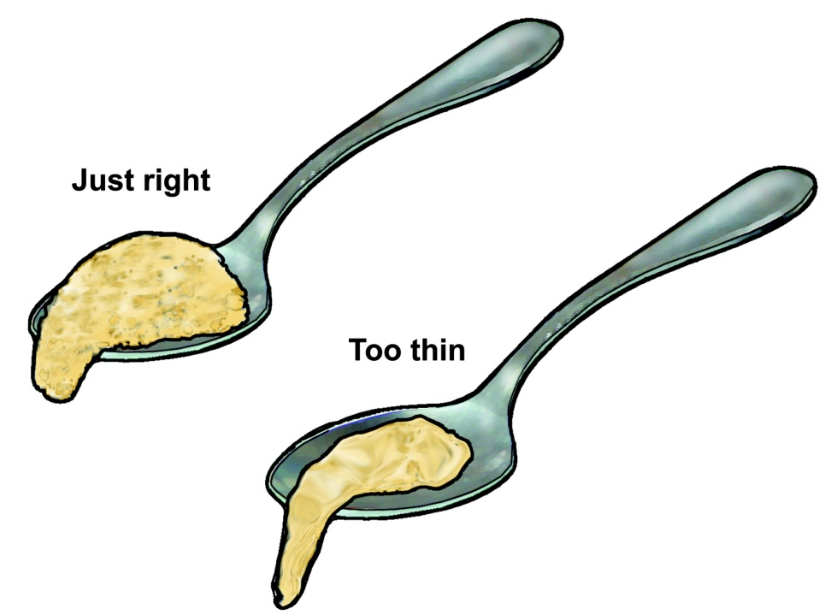
Appropriate Complementary Feeding
Timely: Introduced when need for energy and nutrients exceeds that provided by BF
Adequate: Should provide sufficient energy, protein, micronutrients
Properly Fed: Active feeding method and proper frequency according to age
Safe: Should be hygienically prepared, stored and fed
Right consistency
Soft
Easy to digest
Inexpensive
Locally available
Culturally acceptable
Easily prepared at home

Slide 27
Age of Introduction
Energy Needs
Excl. Breastfeeding
Comp. feeding & continued BF

Slide 28
Importance of continued breastfeeding for 2 years and beyond

Slide 29
Amounts of foods to offer
Age | Texture | Frequency | Amount of each meal
6 months | Soft porridge, well mashed vegetable, meat fruit | 2 times per day plus frequent breastfeeds | 2-3 tablespoonfuls
7-8 months | Mashed foods | 3 times per day plus frequent breastfeeds | Increasing gradually to more than 3/4 of katori (150ml)
9-11 months | Finely chopped or mashed foods, and foods that baby can pick up | 3 meals plus 1 snack between meals plus breastfeeds | a full katori (200ml)
12-24 months | Family foods, chopped or mashed if necessary | 3 meals plus 2 snacks between meals plus breastfeeds | more than katori (250ml)

Slide 30
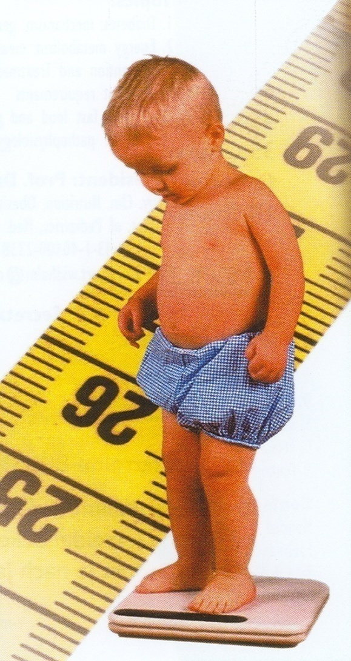
Ensure Adequacy
Growth Monitoring: Measure weight and length periodically and interpret by plotting in growth curves.
Investigate causes of poor growth: Dietary history; evaluate for any illness.
Counsel mother/caregivers on growth, feeding and caring practices

Slide 31
Community-based management of severe acute malnutrition in children
Severe acute malnutrition is defined by a very low weight for height (below -3z scores of the median WHO growth standards), by visible severe wasting, or by the presence of nutritional oedema.
Recent studies suggest that severe acute malnutrition in children above 6 months of age who have no medical complications can be managed at the community level using specially formulated ready-to-use therapeutic foods.
The community-based approach involves timely detection of severe acute malnutrition in the community.
Provision of treatment for those without medical complications with ready-to-use therapeutic foods or other nutrient-dense foods at home.

Slide 32
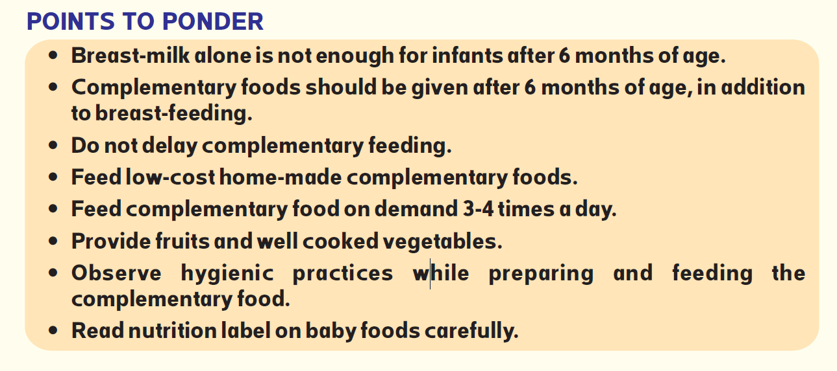
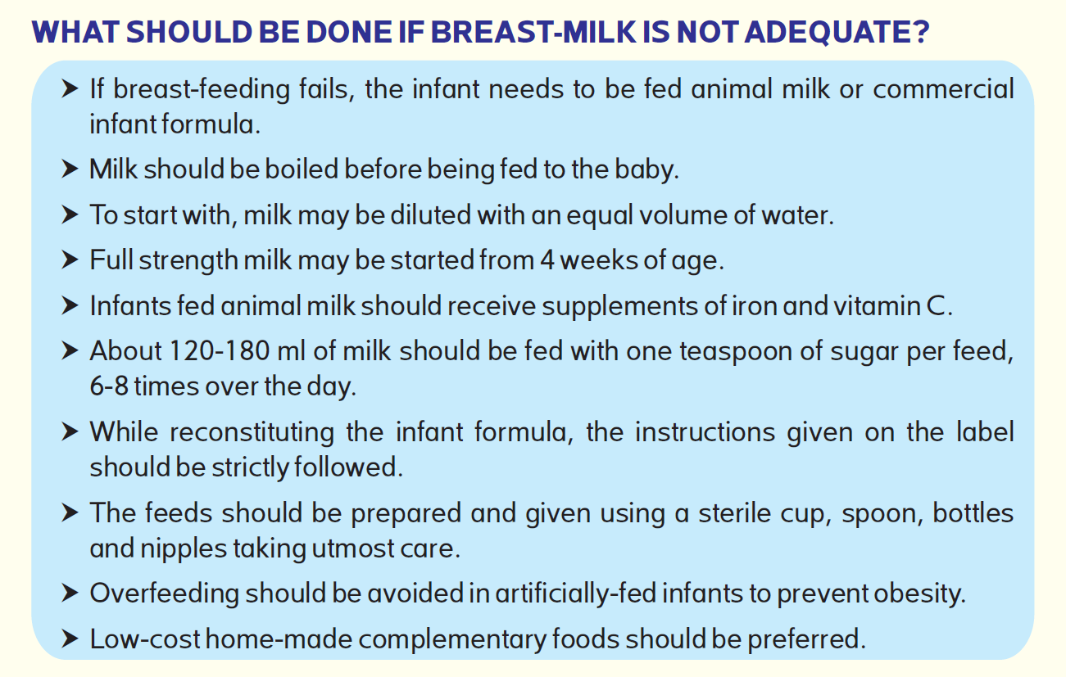
Important messages about Complementary Feeding

Slide 33
10 guiding principle for successful Complementary feeding
Exclusive breastfeeding for 6 months & starting of CF at start of 7 months.
Continue BF ,frequent on demand until 2 years of age and beyond
Responsive Feeding
Safe preparation and storage of CF
Amount of CF needed
Food Consistency
Meal Frequency and energy Density
Nutrient Content of Complementary Feeding
Use of Vitamins-Minerals Supplements or Fortified Products for Infants and mothers
Feeding During and after Illness

Slide 34


